Slide 1



ICEG Interoperability Training
MS Teams (120min)
4 december 2020
#beinterop
start at 10:05

Slide 2
Agreements
Audience is muted and webcam is turned off.
Recording of the session?
Questions, comments or suggestions can be shared via the chat function of MS Teams.
→ Interaction is encouraged!
+1 of -1
A yes/no question can be answered simply and quickly via chat: Agree= +1 Disagree= -1

Slide 3
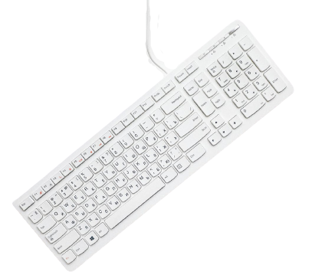
What are your expectations?
(reply via chat)

Slide 4
Agenda
10:05 - 10:50 - plenary
Introduction by Seth van Hooland 10’
Plenary 40’
10:50 - 11:00
BREAK ‘10
11:00 - 11:45 - break-out
Case Saint Nicholas 45’
11:45 - 12:00 - plenary
Wrap-up

Slide 5

10:05 - 10:15 - Introduction
Introduction by Seth Van Hooland

Slide 6
Introduction ISA² EC (10’)
Context : why care about interoperability ?
Core Vocabularies : role and dependencies
Bigger perspective : SDGR + Data Spaces

Slide 7

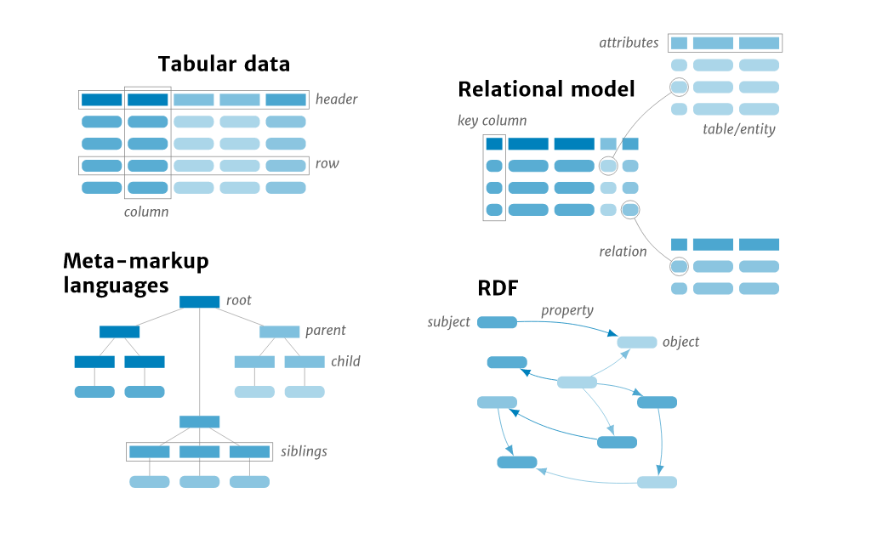
Interoperability: Why care ?

Slide 8
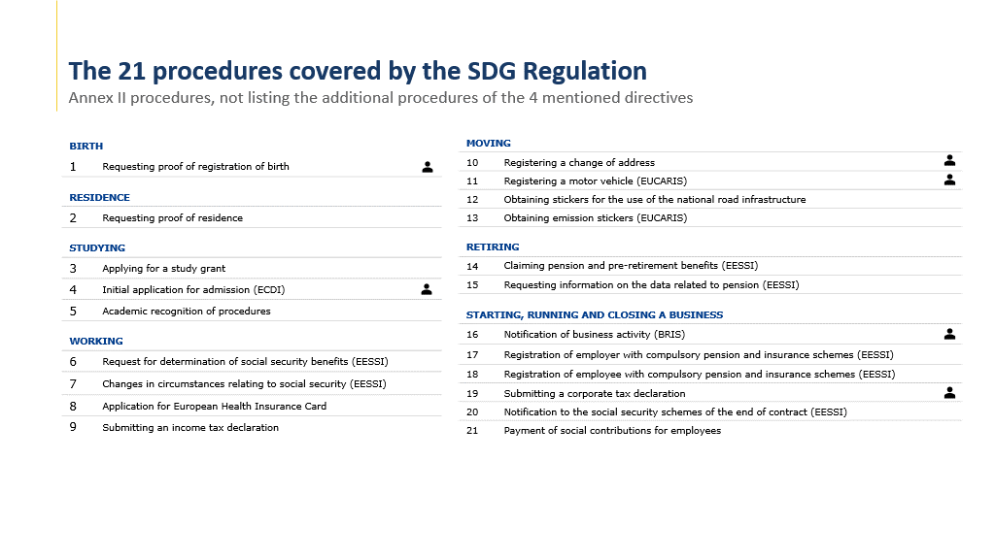
Preparing for the SDG Regulation

Slide 9




10:15 - 10:50 - Plenary
Levels of interoperability
Governance
Semantic data
API’s
Tooling

Slide 10

Levels of interoperability
Interoperability
The ability of different autonomous organizations or systems to communicate and collaborate with each other.

Slide 11
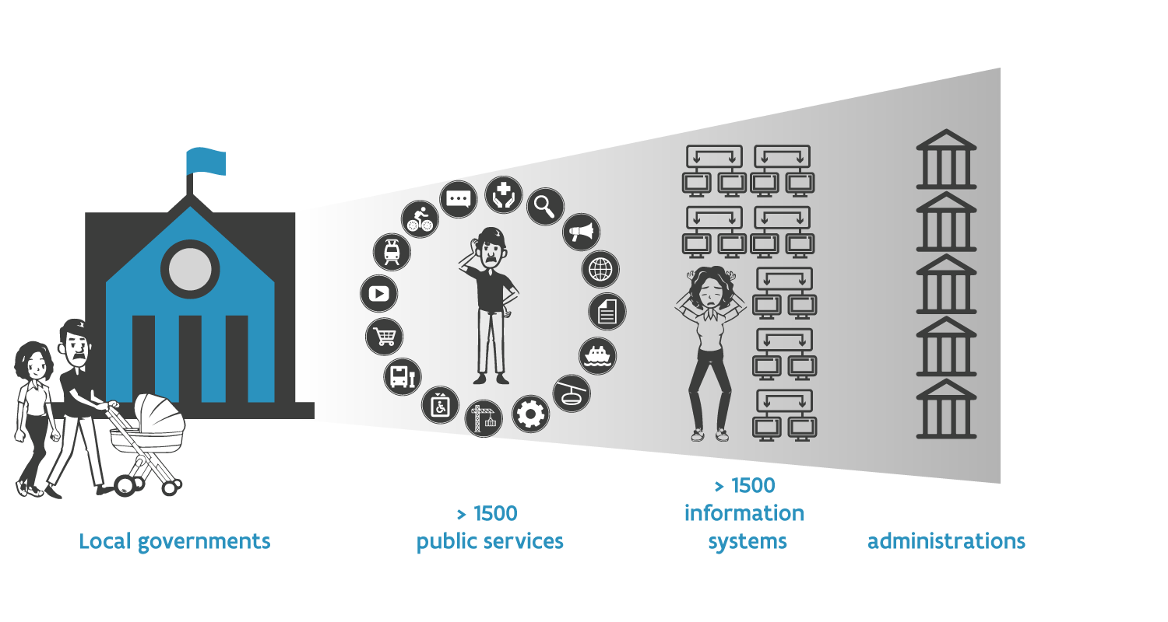
Interoperability: Why important?
> 1000 public services
> 250 information systems
> 1500 public administrations
Local government

Slide 12
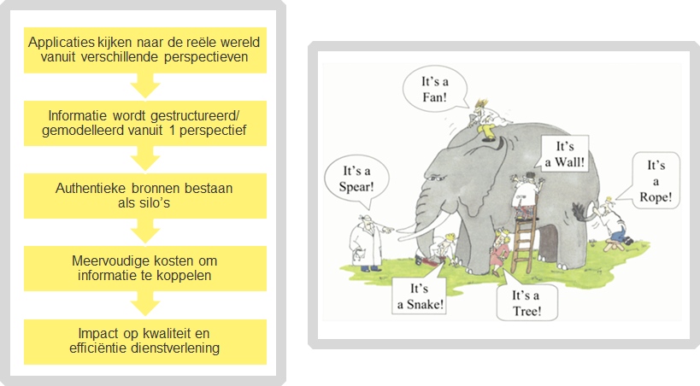
Semantic interoperability
Applications look at the real world from different perspectives
Information is structured/ modeled from 1 perspective
Authentic sources exist as silos
Multiple costs to linked information
Impact on quality and efficiency of service

Slide 13
4 levels of interoperability
refers to inline legislation between different organizations and policy areas
Legal interoperability
Organisational interoperability
aligning business processes between different organisations and policy areas
focuses on the meaning of data elements
Semantic interoperability
Technical interoperability
pertains to the different protocols, formats and interfaces

Slide 14
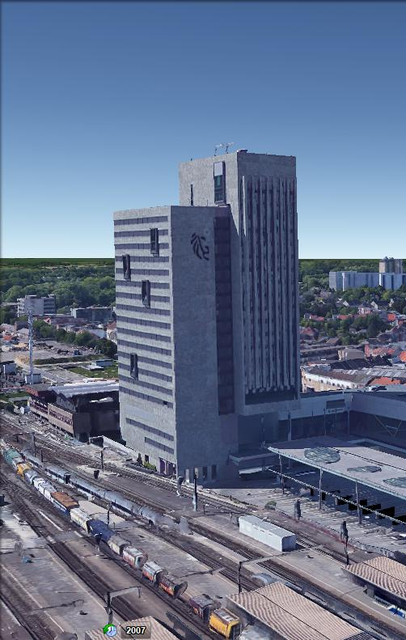
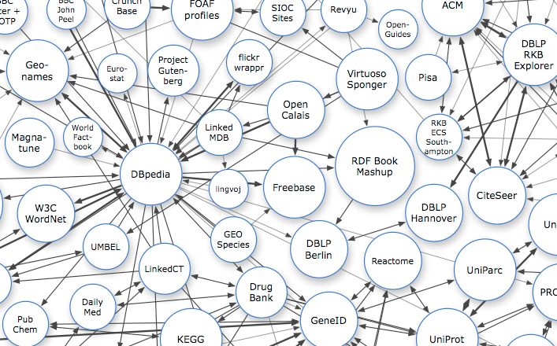
Technical interoperability: The web as a blueprint
Persistent Identifiers: URIs
Dereferencable HTTP URIs
Standardised Information (RDF)
Links to other information
Notes:
Uniform Resource Identifiers (URIs) should be used to name and identify individual things.
HTTP URIs should be used to allow these things to be looked up, interpreted, and subsequently "dereferenced".
Useful information about what a name identifies should be provided through open standards such as RDF, SPARQL, etc.
When publishing data on the Web, other things should be referred to using their HTTP URI-based names.

Slide 15

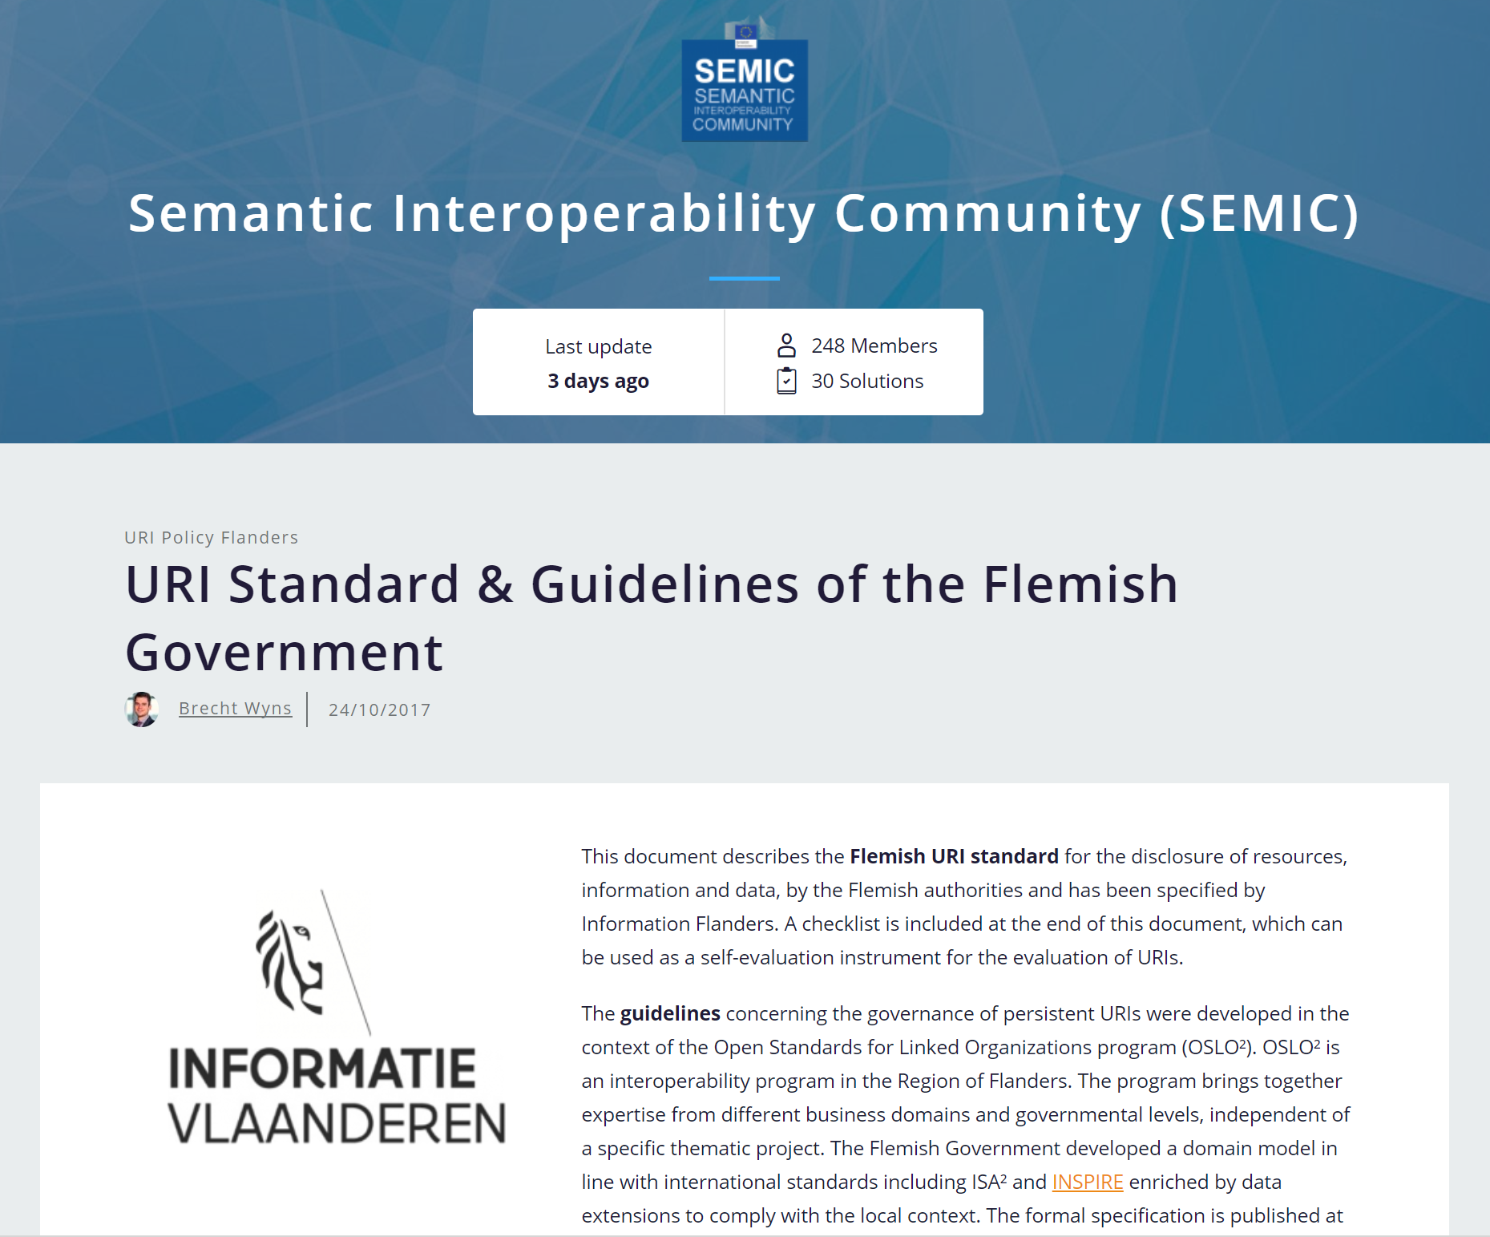
Technical interoperability: The web as a blueprint
Persistent Identifiers: URIs
http://data.vlaanderen.be/id/adres/3706808
Koningin Maria Hendrikaplein 70,
9000 Gent
Dereferencable HTTP URIs
Standardised Information (RDF)
Links to other information

Slide 16
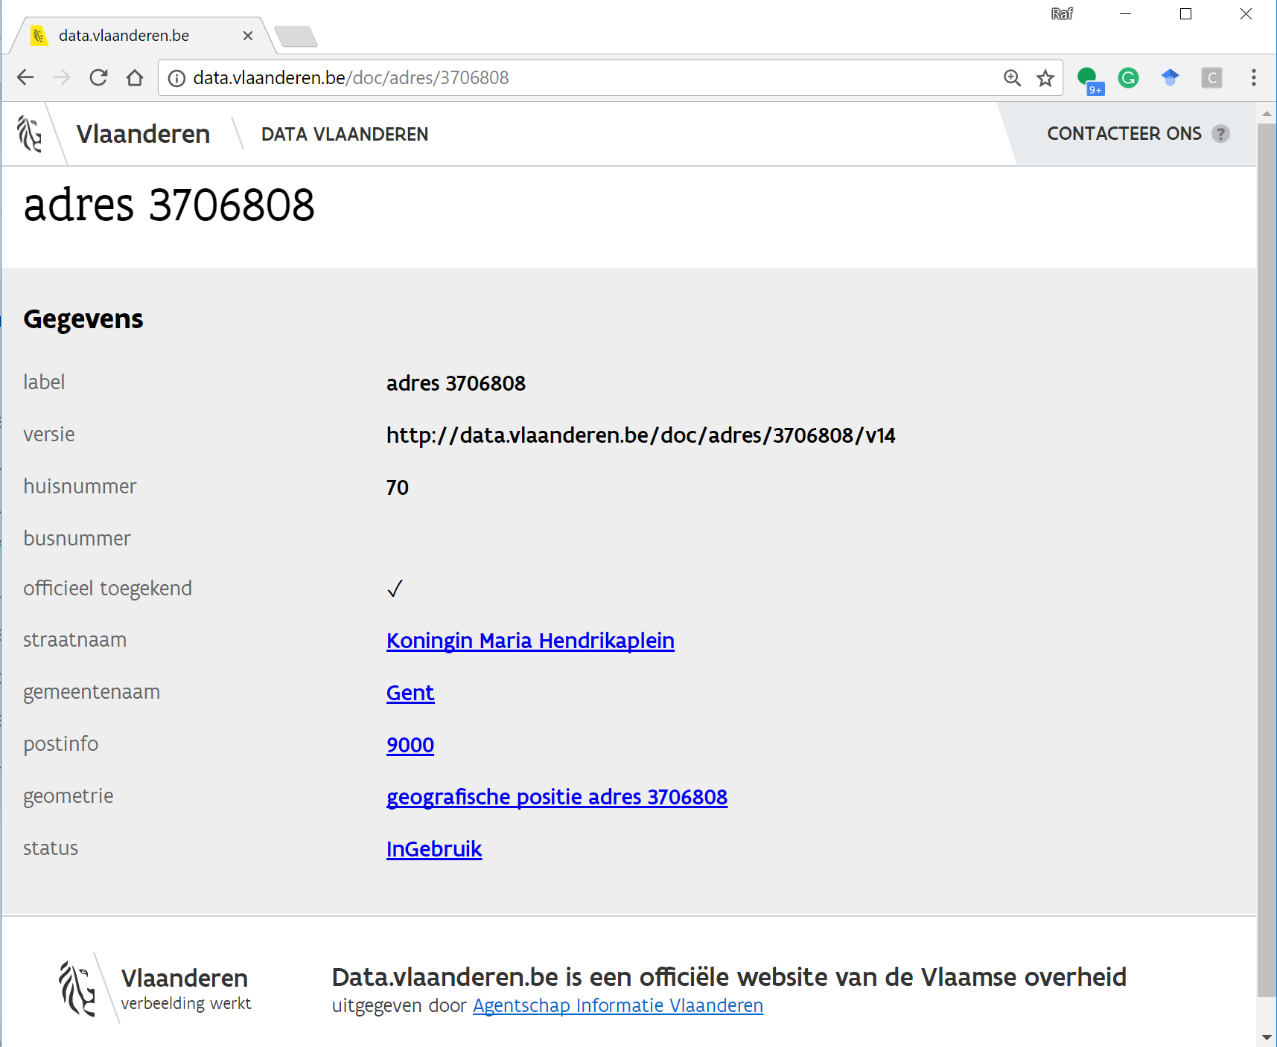
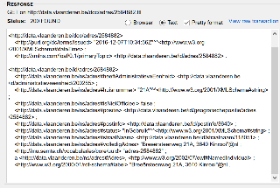
Technical interoperability: The web as a blueprint
Persistent Identifiers: URIs
Dereferencable HTTP URIs
http://data.vlaanderen.be/id/adres/3706808
Gestandaardiseerde Informatie (RDF)
Links naar andere informatie
Mensleesbaar
Computerleesbaar

Slide 17
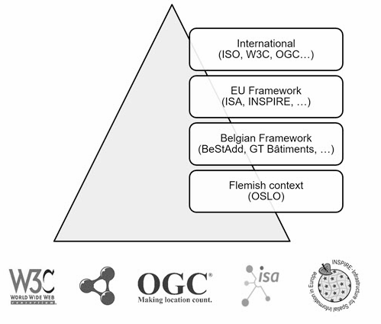
Technical interoperability: The web as a blueprint
Persistent Identifiers: URIs
Dereferencable HTTP URIs
Standardised Information (RDF)
http://data.vlaanderen.be/ns/adres
https://www.w3.org/ns/locn#adminUnitL2
Links to other information

Slide 18
Technical interoperability: The web as a blueprint
Persistent Identifiers: URIs
Dereferencable HTTP URIs
Standardised Information (RDF)
Links to other information
data.vlaanderen.be/id/organisatie/OVO002949
Agentschap Informatie Vlaanderen
http://data.vlaanderen.be/id/adres/3706808
Koningin Maria Hendrikaplein 70
9000 Gent

Slide 19
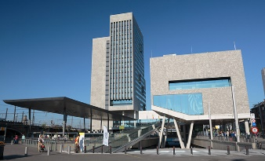

Technical interoperability: URI’s
VO:Gebouw:2132
Identificator 2132
https://data.vlaanderen.be/id/gebouw/2132
By saving a reference
By taking over all the data
{
“buildingName”: “VAC GENT”,
“buildingYear”: “2010”,
“E-level” : “50”,
“address”: “Maria Hendrikaplein 90”
…
}
time

Slide 20

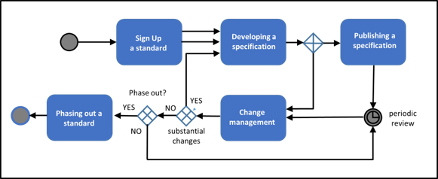
Governance: ICEG process and method
Scalable process for registering, developing, changing and phasing out data standards.
Abstract: French, Dutch
Full paper: English
W3C, IEEE, IETF, IAB en ISA, Open Stand, OSLO​

Slide 21
Governance: ICEG mission statement and roles
The ICEG* review group ‘open standards’ has a permanent character and is responsible for the central coordination and follow-up of the work related to the standardisation of information.
Mission aligned to the existing ICEG collaboration agreement between the federal, regional and community authorities (dd. 2013-08-26).
The work is part of the standardisation of:
•meaning of the information (semantic),
•syntax (grammar) and technical standards for the exchange of the information
•metadata for discoverability ('data on data’).
In addition, the working group monitors
•mutual consistency of standards,
•international standards that impact governments in Belgium
•generic development and the change process.
The working group on data standards gathers on a regular basis.
(*) ICEG = Interfederal Collaboration on e-Government

Slide 22
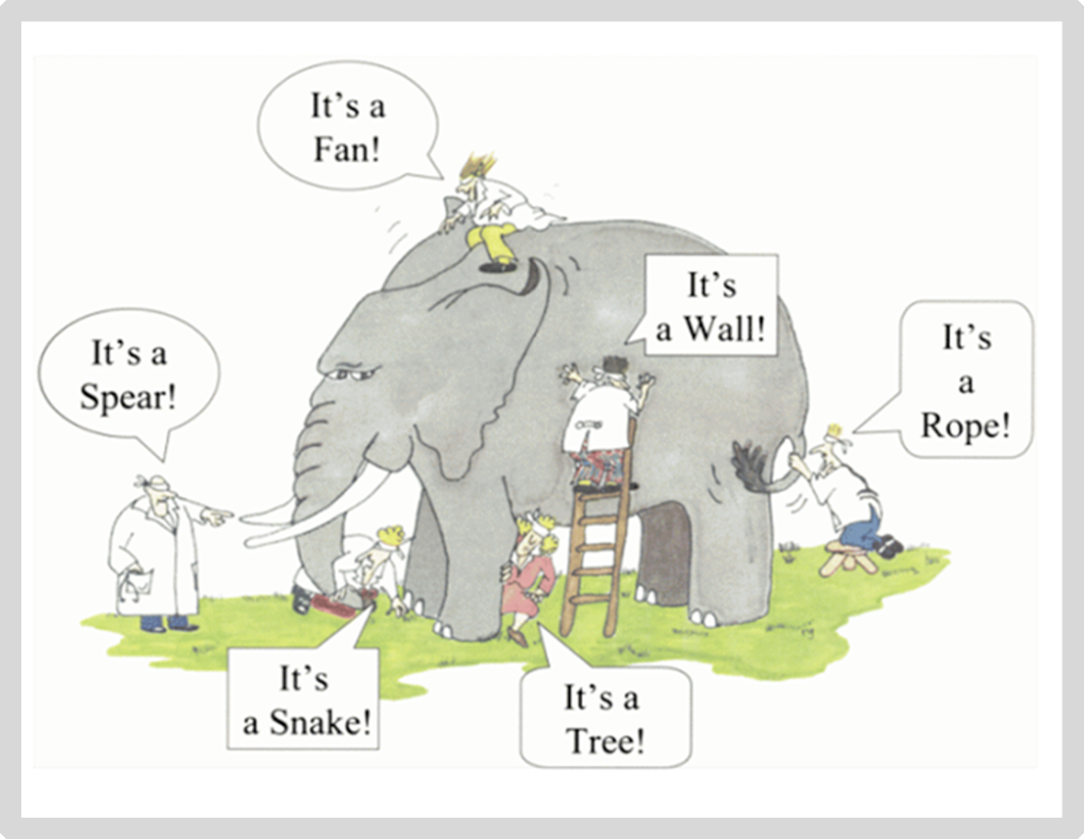
It’s all about the context

Slide 23
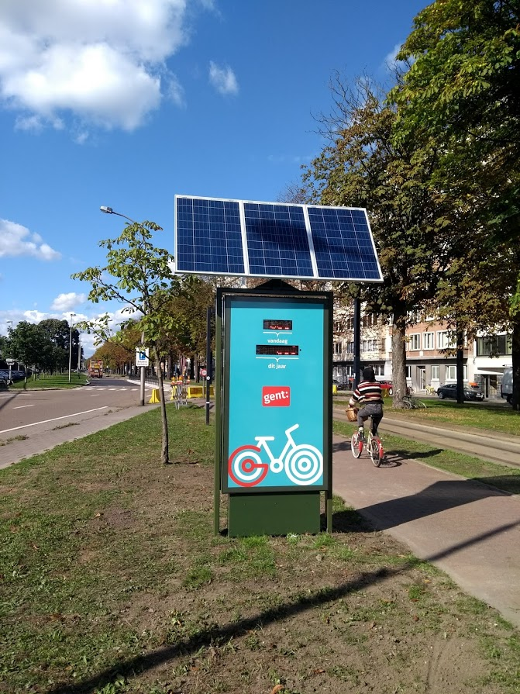
I want to exchange data
JSON
{
“Fietsteller-Zuid” : {
“type” : “BicycleCounter”,
“city” : “Ghent”,
“today” : “100”
}
}

Slide 24
But how do we understand each other?
JSON
{
“Fietsteller-Zuid” : {
“type” : “BicycleCounter”,
“city” : “Ghent”,
“today” : “100”
}
}
Table / CSV / Spreadsheet
name | type | location | number
F7 Gent-Kortrijk | BikePassageCounter | Waregem | 250

Slide 25
We know, but machines don’t
Triples!
<Fietsteller-Zuid> <type> <BicycleCounter>
<Fietsteller-F7> <type> <BikePassageCounter>
<Fietsteller-Zuid> <today> <100>
<Fietsteller-F7> <number> <250>
→ BicycleCounter is the same as a BikePassageCounter
→ Number basically means the same as today in this context

Slide 26
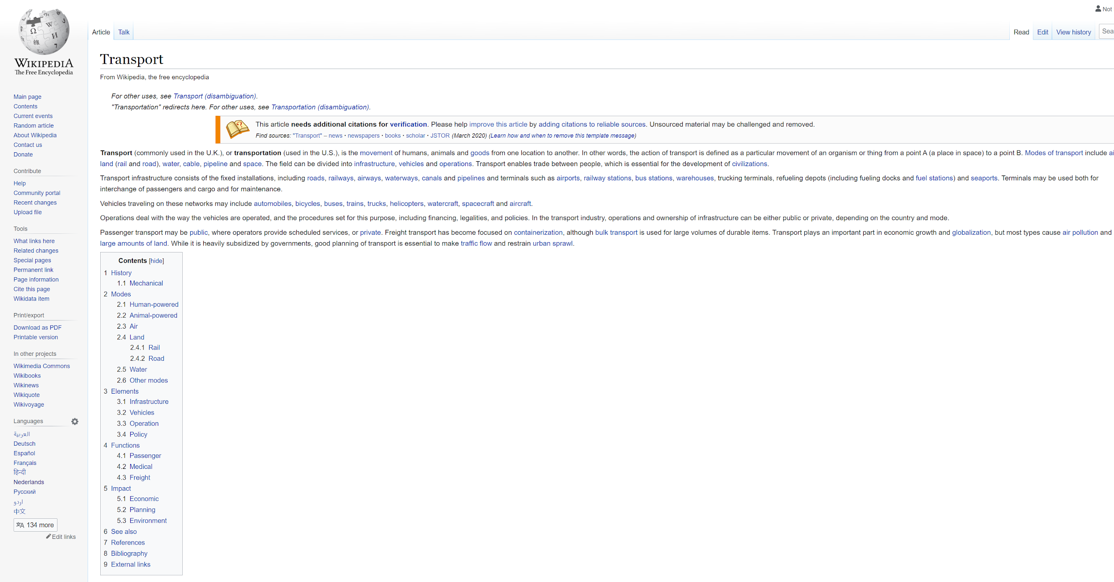
Solved by using URIs
<Fietsteller-Zuid> <type> <BicycleCounter>
<Fietsteller-F7> <type> <BikePassageCounter>
<Fietsteller-Zuid> <today> <100>
<Fietsteller-F7> <number> <250>
<Fietsteller-Zuid> <type> <BicycleCounter>
<Fietsteller-F7> <type> <BikePassageCounter>
<Fietsteller-Zuid> <today> <100>
<Fietsteller-F7> <number> <250>
https://wikipedia.org/BikeCounter
But machines only get a human readable description (HTML)
URI = Uniform Resource Identifier
Notes:
Uitleggen dat als URI’s we ook konden gekozen hebben voor ISBN nummers omdat die over gans de wereld een boek uniek identificeren, maar dat die niet dereferencieerbaar zijn.
We gebruiken daarom de kracht van het Web en kiezen voor URL’s als URI’s

Slide 27
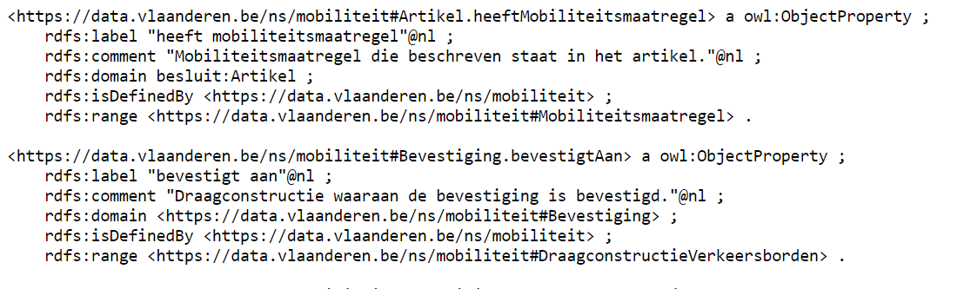
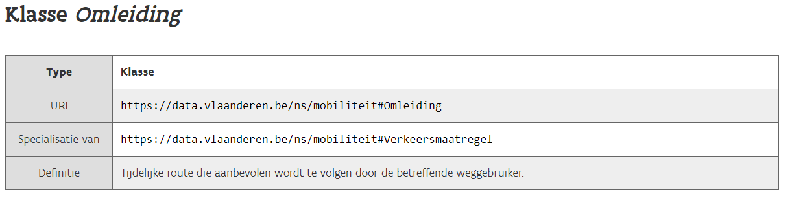
We use URIs that provide both a human and machine
readable description
<Fietsteller-Zuid> <type> <BicycleCounter>
<Fietsteller-F7> <type> <BikePassageCounter>
<Fietsteller-Zuid> <today> <100>
<Fietsteller-F7> <number> <250>
https://data.vlaanderen.be/ns/example#BikeCounter
Human readable
Machine readable

Slide 28
Applying context and URI’s to our example,
creating JSON-LD
{
“@context” : {
“BicycleCounter” : “https://data.vlaanderen.be/ns/example#BikeCounter”
“today” : “https://data.vlaanderen.be/ns/example#totalNumberOfBicycles”
},
“@id” : “https://example.org/id/Fietsteller-Zuid”,
“@type” : “BicycleCounter”,
“today” : 100
}
{
“@context” : {
“BikePassageCounter” : “https://data.vlaanderen.be/ns/example#BikeCounter”
“number” : “https://data.vlaanderen.be/ns/example#totalNumberOfBicycles”
},
“@id” : “https://example.org/id/Fietsteller-F7”,
“@type” : “BikePassageCounter”,
“number” : 250
}

Slide 29
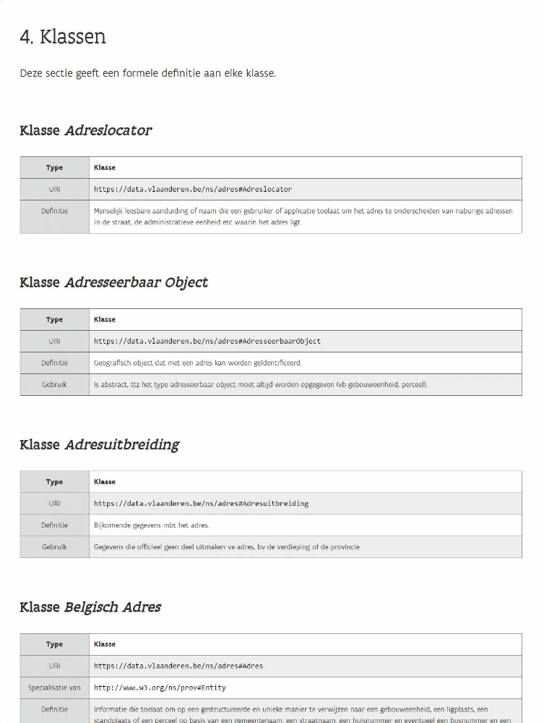
Vocabularies & Application Profiles
Vocabularies contain a list of terms
per domain
→ For example: address, organization, person, ...

Slide 30
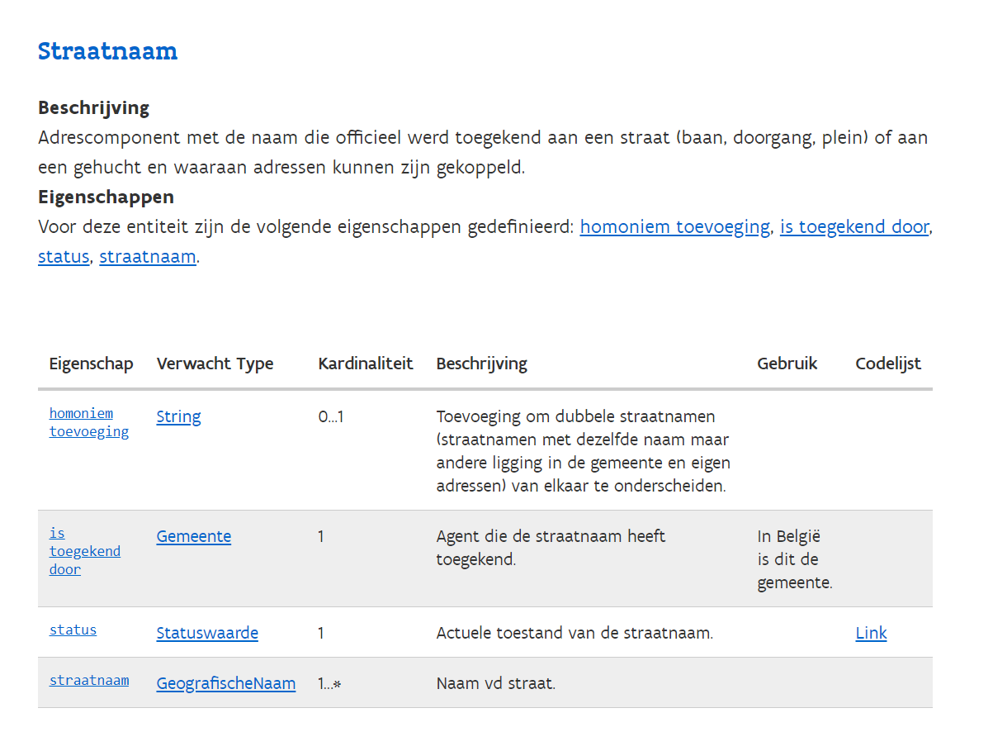
Vocabularies & Application Profiles
Application profiles determine which
data must be exchanged
→ For example: a street name
Notes:
Create gif?

Slide 31
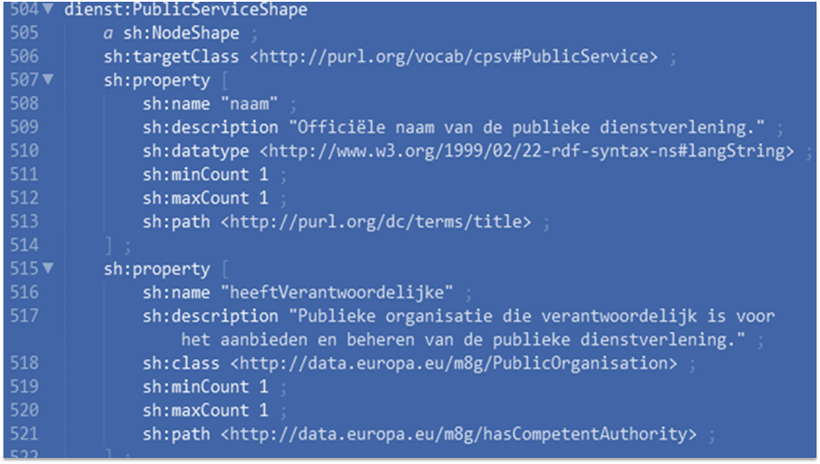
I have an API that publishes semantic data
Is my data in line with these standards? (compliance)
→ Technical contracts as SHACL* ensure this.
A document with a set of conditions
SHACL = Shapes Constraints Language

Slide 32
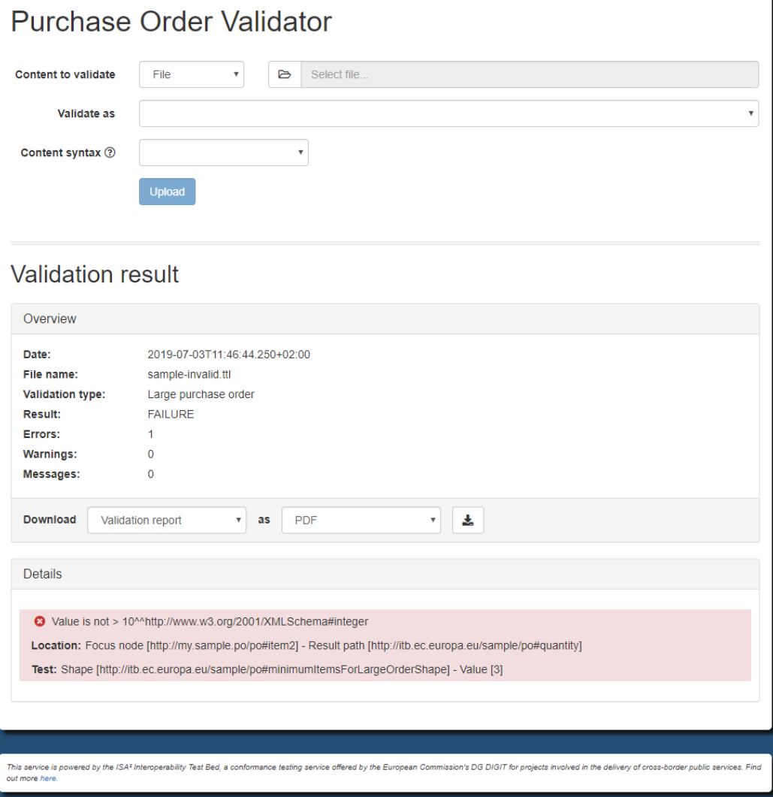
Tooling: SHACL-validator
Europe provides tools to do this automatically: RDF validator
Frontend
REST API
SOAP API
Flanders built its own frontend on top of the EU backend

Slide 33

Case “Saint Nicholas”

Slide 34
Exercise
In groups (NL, FR, ENG) we will go through the exercise of making our own implementation model.
The purpose is to get familiar with building implementation models.

Slide 35
[FR] - Thierry | [FR] - Olivier-Pascal | [ENG] - Raf/Eveline | [NL] - Dwight | [NL] - Liesbet
Raphaelle Claude (Archives de l’Etat en Belgique) | Patrick Legrand (SPF Finance) | Pieter Huybrechts (Agentschap Plantentuin Meise) | Wouter Claes (Koninklijke Musea voor Kunst en Geschiedenis) | Ann Van Camp (KBR, Koninklijke Bibliotheek van België)
Maxime Doyen (BCSS) | Stefano Tarallo (SPF Finances) | Eric Laureys (Belspo) | Kris Neyts (NBB) | Tom Bultynck (FOD BOSA)
Eric Danon (Belspo) | Olesya Lee (SPF Finances) | Levi Boey (Buza) | Valerie Vrancken (Rijksarchief) | Rudy Staelens (FOD BOSA)
Javier Sawchik (Federal agency for medicines and health products) | Antoine Bouxom (SPF Finances) | Gaetan Muyldermans (Sciensano) | Ann Pannecoucke (Regie der Gebouwen) | Goedele Hubrechts (FOD Economie)
Lidwine Do Huu (Fednot) | Sobrie Laurent (SPF Justice) | Roxanne Wyns (KuLeuven) | Nico Smets (Regie der Gebouwen) | Isabelle Arickx (FOD BOSA)
Sébastien Burick (La Régie des Bâtiments) | Régine Kiasuwa Mbengi (Sciensano) | Sharma Subhalakshmi (Sciensano) | Lieven De Tant (Regie der Gebouwen) | Johan Van der Eycken (Rijksarchief)
Alexandre Aude (Musées royaux des Beaux-Arts de Belgique) | Odile Keromnes (Musées royaux des Beaux-Arts de Belgique) | Brecht Devleesshauwer (Sciensano) | Rink W. Kruk (Nationaal Geografisch Instituut) | Patricia Mergen (Agentschap Plantentuin Meise)
Miguel Discart (SPF Economie) | Yolande Lenga (Sciensano) | Wim Bonneux (FOD Financiën) | Mieke Van Mulders (Sciensano) | Lieven Jacobs (FOD Mobiliteit en Vervoer)
Christophe Avonture (SPF BOSA) | Veronique Adam (Smals) | Chris De Loof (Belspo) | Kim Van Roey (Sciensano) | Johan Steylaerts (Car-Pass vzw)
Geraldine Boseret (Sciensano) | Joël Frankson (SPF BOSA) | Roel Heijlen (Sciensano) | Niki Van Strydocnk (FOD BOSA) | Hilde Blondeel (FOD Financien)
Isabel Sastre Cantano (Smals) |  | Yves Lorphelin (BOSA DG-R&O) | Bart De Buck (FOD Economie) | Nacha Van Steen (KMKG)
 |  |  | Melissa Van Bossuyt (Sciensano) | Zeb Luts (FOD Financien)
Notes:
Links naar de MS Teams:
PLENAIR:
Klik hier om deel te nemen aan de vergadering
Group 1 [FR]: Thierry
Klik hier om deel te nemen aan de vergadering
Group 2 [FR]: Pascal
Klik hier om deel te nemen aan de vergadering
Group 3 [ENG]: Raf
Klik hier om deel te nemen aan de vergadering
Group 4 [NL]: Dwight
Klik hier om deel te nemen aan de vergadering
Group 5 [NL]: Liesbet
Klik hier om deel te nemen aan de vergadering

Slide 36

5 break out rooms in MS Teams
Group 1 [FR]: Thierry https://bit.ly/group1iceg
Group 2 [FR]: Pascal https://bit.ly/group2iceg
Group 3 [ENG]: Raf https://bit.ly/group3iceg
Group 4 [NL]: Dwight https://bit.ly/group4iceg
Group 5 [NL]: Liesbet https://bit.ly/group5iceg

Slide 37
1. Define use case
2. List and inventarize relevant concepts
3. Study and look for existing vocabularies and AP’s
4. Map your concepts on the existing vocabularies and AP’s
5. Find a solution for unmapped concepts
6. Establish an implementation model

Slide 38


Timeline exercise (45’)
Step 1: Define use case (5’)
Intro (5’)
Step 2: List and inventarize concepts (10')
Intro (2')
Execute (8')
Step 3: Look for existing voc’s and AP’s (10')
Intro (2')
Execute (8')
Step 4: Map your concepts (5')
Intro (2')
Execute (3')
Step 5: Find a solution for unmapped concepts (5')
Intro (5')
Step 6: Establish an implementation model (10')
Intro (10')

Slide 39
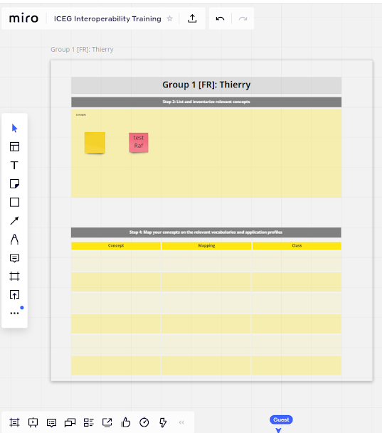
How to connect to Miro?
https://bit.ly/whiteboardiceg
Follow the link to the Miro Whiteboard.
Explore the board.
Notes:
Move nog toevoegen

Slide 40



Slide 41

11:00 - 11:45 - Case “Saint Nicholas”
Illustration of the case
5 break-out rooms

Slide 42
1. Define use case
2. List and inventarize relevant concepts
3. Study and look for existing vocabularies and AP’s
4. Map your concepts on the existing vocabularies and AP’s
5. Find a solution for unmapped concepts
6. Establish an implementation model

Slide 43
Timeline exercise (45’)
Step 1: Define use case (5’)
Intro (5’)
facilitator explains use case
Step 2: List and inventarize concepts (10')
Intro (2') -<w go to miro and
Execute (8')
Step 3: Look for existing voc’s and AP’s (10')
Intro (2')
Execute (8')
Step 4: Map your concepts (5')
Intro (2')
Execute (3')
Step 5: Find a solution for unmapped concepts (5')
Intro (5')
Step 6: Establish an implementation model (10')
Intro (10')
Notes:
concepten uit de use case halen die ze herkennen. Moderator overloopt de verschillende concepten and clusters towards the predefined concepts in slides 47 (this is the solution)

Slide 44
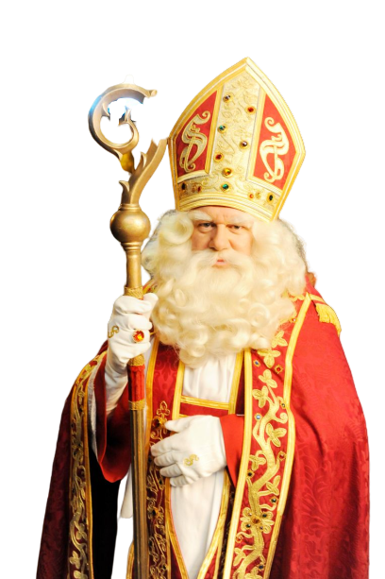
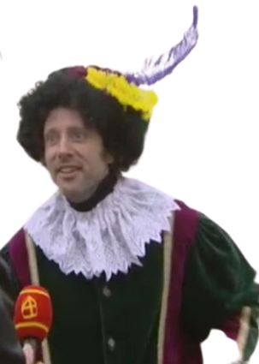

Step 1
Step 1: Define use case
Step 2
Step 3
Step 4
Several stakeholders with different requirements:
Step 5
Step 6
Purchase management
Budget management
Logistic planning so that all gifts are delivered on time
Pass on wish list
Receive a gift
Notes:
Different user requirements from different stakeholders we will not focus on ALL these requirements in the use case to make it more easy to explain.

Slide 45

Step 1
Step 1: Define use case
Step 2
Step 3
Step 4
Step 5
Use case:
Child receives gift on “pakjesavond” from the Sint and his colleagues
Child only receives a gift when he/she has been good.
The address where the gift should be brought should have a chimney.
The gift should be bought from a supplier.
Step 6
solution

Slide 46
1. Define use case
2. List and inventarize relevant concepts
3. Study and look for existing vocabularies and AP’s
4. Map your concepts on the existing vocabularies and AP’s
5. Find a solution for unmapped concepts
6. Establish an implementation model

Slide 47


Step 1
Step 2: List and inventarize relevant concepts
Step 2
Step 3
Step 4
Step 5
Step 6
Exercise: List the information-elements needed to implement the use case.
An example
Use case: I want to build an application where the nearest toilet will be displayed.
Concepts or information-elements needed:
Location (of the user, the toilets)
..
Concept
Location
Concept 2
Concept 3
Concept 4
Concept 5
…
Our use case:
Child receives gift on “pakjesavond” from the Sint and his colleagues
Child only receives a gift when he/she has been good.
The address where the gift should be brought should have a chimney.
The gift should be bought from a supplier.

Slide 48
Step 1
Step 2: List and inventarize relevant concepts
Step 2
Step 3
Step 4
Step 5
Concepts
Sint
Piet
Kind
Gift
Pakjesavond
Address
Supplier
...
Solution
Child receives gift on “pakjesavond” from the “Sint” and his “pieten”
Child only receives a gift when he/she has been good.
The address where the gift should be brought should have a chimney.
The gift should be bought from a supplier and has a certain price.
Step 6
solution

Slide 49
1. Define use case
2. List and inventarize relevant concepts
3. Study and look for existing vocabularies and AP’s
4. Map your concepts on the existing vocabularies and AP’s
5. Find a solution for unmapped concepts
6. Establish an implementation model

Slide 50

Step 1
Step 3: Look for existing vocabularies and AP’s
Step 2
Step 3
Step 4
Step 5
Browse to data.vlaanderen.be/ns where you can view the existing OSLO vocabularies and application profiles.
Explore the AP’s and see what you find interesting, eg: “Persoon Basis”, “Organisatie”, “Dienstencataloog”, ..
Click on the classes to jump to the vocabulary.
Write down the classes (eg. “Adres”, “Persoon”, “Organisatie”) that are relevant and reusable for this case.
Step 6

Slide 51
Step 1
Step 3: Look for existing vocabularies and AP’s
Step 2
Step 3
Step 4
Step 5
We can re-use the following existing (OSLO) classes:
OSLO klasse 1: Persoon
OSLO klasse 2: Adres
OSLO klasse 3: Geregistreerde organisatie
OSLO klasse 4: Publieke dienstverlening
Step 6
solution

Slide 52
1. Define use case
2. List and inventarize relevant concepts
3. Study and look for existing vocabularies and AP’s
4. Map your concepts on the existing vocabularies and AP’s
5. Find a solution for unmapped concepts
6. Establish an implementation model

Slide 53
Step 1
Step 4: Map your concepts on existing vocabularies and
AP’s
Step 2
Step 3
Step 4
Step 5
Put the necessary concepts (identified in step 2) next to the existing (OSLO) classes (step 3) to identify the differences and similarities.
Provide a mapping value (SKOS) to the overlap (see next slide):
Exact match
Related match
Broad match
Narrow match
No match
Step 6

Slide 54
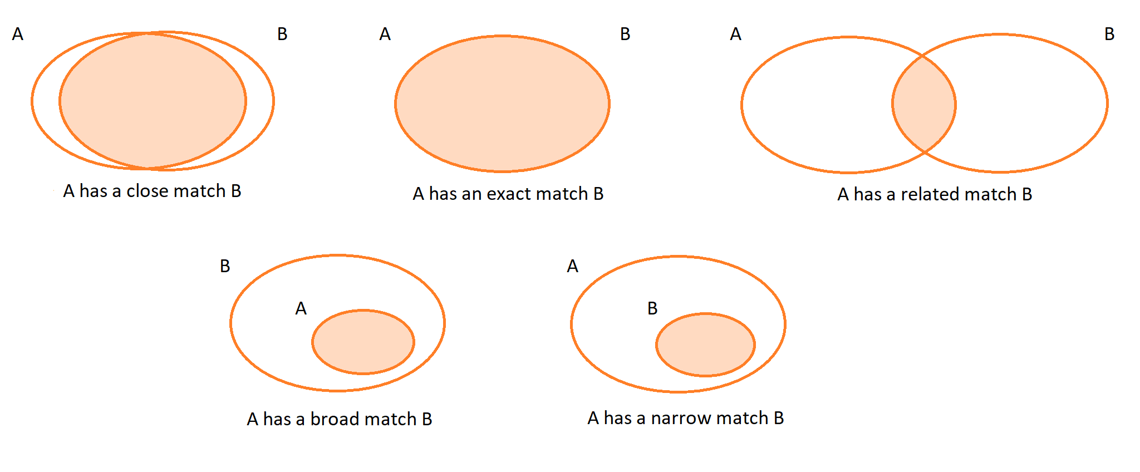
Step 1
Step 4: SKOS mapping
Step 2
Step 3
Step 4
Step 5
Step 6
source and more information via: https://bit.ly/userhandbookisa (p.22-23)

Slide 55
Step 1
Step 4: Map on existing voc’s and AP’s
Step 2
Step 3
Step 4
Exercise: Make a mapping with our concepts (see step 2) and relevant classes from existing vocabularies and application profiles.
Step 5
Step 6
Concept | Mapping | Class
Sint
Piet
Kind
Cadeau
Pakjesavond
Adres
Leverancier
...

Slide 56
Step 1
Step 4: Map on existing voc’s and AP’s
Step 2
Step 3
Step 4
Exercise: Make a mapping with our concepts (see step 2) and relevant classes from existing vocabularies and application profiles.
Step 5
Step 6
Concept | Mapping | Class
Sint | Exact match | OSLO-Persoon::Persoon
Piet | Exact match | OSLO-Persoon::Persoon
Kind | Exact match | OSLO-Persoon::Persoon
Cadeau | ?? | ??
Pakjesavond | Exact match | OSLO-PubliekeDienstverlening::Dienst
Adres | Narrow match | OSLO-Adres::Adres
Leverancier | Exact match | OSLO-Organisatie::GeregistreerdeOrganisatie
... | .. | ..
solution

Slide 57
1. Define use case
2. List and inventarize relevant concepts
3. Study and look for existing vocabularies and AP’s
4. Map your concepts on the existing vocabularies and AP’s
5. Find a solution for unmapped concepts
6. Establish an implementation model

Slide 58
Step 1
Step 5: Find a solution for unmapped concepts
Step 2
Step 3
Step 4
Step 5
Look at international standards and vocabularies.
tip: https://lov.linkeddata.es/
DC terms
schema.org
dbpedia.org
Legislation and other official documents at Flemish, Belgian and European level.
Models that are already in use by other public administrations in Flanders, Belgium or Europe. An example is the INSPIRE data models.
Step 6

Slide 59
Step 1
Step 5: Some guidelines
Step 2
Step 3
Step 4
Step 5
Check whether there are already international data standards that define the necessary.
Only in last instance define something completely yourself.
For these new entities:
Check whether these are also relevant in a different context, for other parties, in the context of information exchange and whether an alignment process should be started around this.
For things that don’t seem to match completely:
See if your information model cannot be adjusted.
If not: OSLO and other data standards can be changed. Feel free to send a comment!
If alignment is not possible in one of these 2 ways, please rename it.
Step 6

Slide 60
Step 1
Step 5: Find a solution for unmapped concepts
Step 2
Step 3
Step 4
Exercise: Find a solution for unmapped concepts by looking at international standards.
Step 5
Step 6
Concept | Mapping | Class
Sint | Exact match | OSLO-Persoon::Persoon
Piet | Exact match | OSLO-Persoon::Persoon
Kind | Exact match | OSLO-Persoon::Persoon
Cadeau
Pakjesavond | Exact match | OSLO-PubliekeDienstverlening::Dienst
Adres | Narrow match | OSLO-Adres::Adres
Leverancier | Exact match | OSLO-Organisatie::GeregistreerdeOrganisatie
...

Slide 61
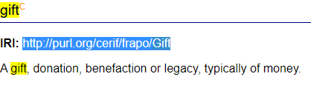
Step 1
Step 5: Find a solution for unmapped concepts
Step 2
Step 3
Step 4
Exercise: Find a solution for unmapped concepts by looking at international standards.
Step 5
Step 6
Concept | Mapping | Class
Sint | Exact match | OSLO-Persoon::Persoon
Piet | Exact match | OSLO-Persoon::Persoon
Kind | Exact match | OSLO-Persoon::Persoon
Cadeau | Related match | http://purl.org/cerif/frapo/Gift
Pakjesavond | Exact match | OSLO-PubliekeDienstverlening::Dienst
Adres | Narrow match | OSLO-Adres::Adres
Leverancier | Exact match | OSLO-Organisatie::GeregistreerdeOrganisatie
...
solution

Slide 62
1. Define use case
2. List and inventarize relevant concepts
3. Study and look for existing vocabularies and AP’s
4. Map your concepts on the existing vocabularies and AP’s
5. Find a solution for unmapped concepts
6. Establish an implementation model

Slide 63
Step 1
Step 6: Establish an implementation model
Step 2
Step 3
Step 4
A few guidelines for establishing an implementation model:
Step 5
Start from the entities we have listed.
An entity= concepts/information elements that make up the information model
Add attributes to the model
An attribute= a property of a particular entity
Add relationships to the model:
A relationship= the relationships between the entities
Add cardinalities to the model.
Showing how many times a relationship can occur (see example next slide)
(Make definitions more concrete).
Step 6

Slide 64
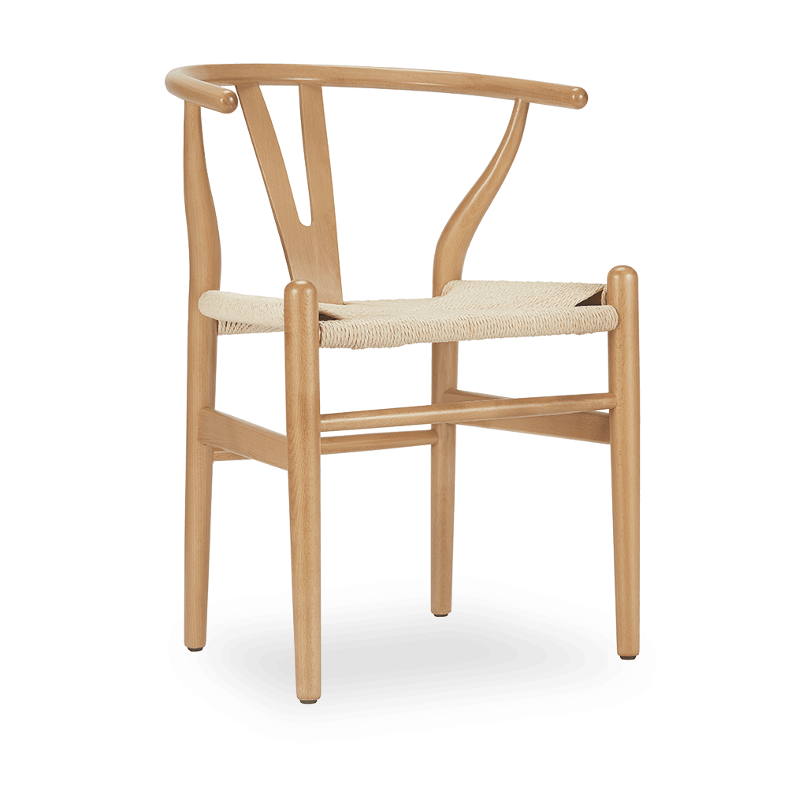
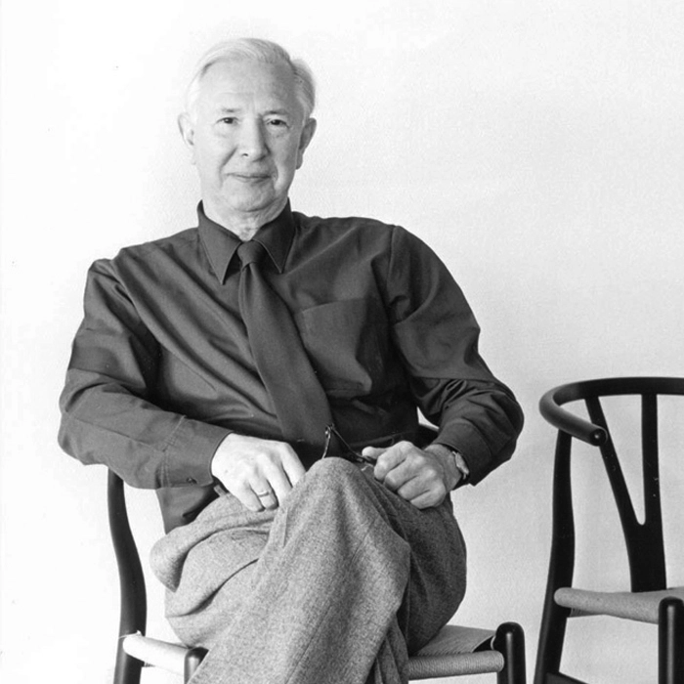
Step 1
Step 6: Establish an implementation model
Step 2
Step 3
Step 4
Cardinalities explained with an example:
Step 5
Step 6
has serial number
78034
1
1
has designer
0..*
1
is made of
<oak>
<papercord>
<Wishbone chair>
<Hans J. Wegner>
0..*
0..*
Notes:
The cardinalities says something on how many times a relationship can occur. There exist 3 types of relations:
1-to-1 relation: The Wishbone chair has only one unique serial number. And one serial number only belongs to one single chair.
1-to many-relation: The Wishbone chair has only one designer which is Hans Wegner. But Hans Wegner designed many (=*) other chairs.
Many-to-many relation: The Wishbone chair is made of multiple materials for example oak and papercord. But many things are made of the same materials.

Slide 65
Step 1
Step 6: Establish an implementation model
Step 2
Step 3
Step 4
Step 5
Concept 1
Concept 2
Step 6
- Attribuut 1
- Attribuut 2 - Attribuut 3
- Attribuut 1
- Attribuut 2 - Attribuut 3
relatie 1 🡪
Subconcept 3
- Attribuut 1
- Attribuut 2 - Attribuut 3

Slide 66
Step 1
Step 6: Establish an implementation model
Step 2
Step 3
Step 4
An example:
Step 5
Object: Chair
Person
Step 6
- Name
- Serial number - Color
- Name
- Address - Birth place
Designer
- Atelier
- ..
has 🡪

Slide 67
Step 1
Step 6: Establish an implementation model
Step 2
Step 3
Step 4
OSLO::Publieke Dienstverlening
Pakjesavond
- beschrijving: tekst [0..1]
solution

Slide 68
Step 1
Step 6: Establish an implementation model
Step 2
Step 3
Step 4
OSLO::Publieke Dienstverlening
Pakjesavond
OSLO::Persoon
OSLO::Persoon
Step 5
Step 6
- beschrijving: tekst [0..1]
- voornaam: tekst [1]
- achternaam: tekst [1]
heeft verantw. ▶
Sinterklaas
Piet
Kind
- leeftijd: getal [0..1] - stout: ja/nee [1]
heeft uitvoerder ▶
solution

Slide 69
Step 1
Step 6: Establish an implementation model
Step 2
Step 3
Step 4
OSLO::Publieke Dienstverlening
Pakjesavond
OSLO::Persoon
OSLO::Persoon
OSLO::Adres
Adres
Step 5
woont op ▶
Step 6
- beschrijving: tekst [0..1]
- voornaam: tekst [1]
- achternaam: tekst [1]
- land [1] - gemeente [1]
- straatnaam [1]
- huisnummer [1]
- busnummer [0..1]
- schoorsteenAanwezig [0..1]
heeft verantw. ▶
Sinterklaas
Piet
Kind
- leeftijd: getal [0..1] - stout: ja/nee [1]
heeft uitvoerder ▶
solution

Slide 70
Step 1
Step 6: Establish an implementation model
Step 2
Step 3
Step 4
OSLO::Publieke Dienstverlening
Pakjesavond
OSLO::Persoon
OSLO::Persoon
OSLO::Adres
Adres
Step 5
- voornaam: tekst [1]
- achternaam: tekst [1]
woont op ▶
Step 6
- beschrijving: tekst [0..1]
- land [1] - gemeente [1]
- straatnaam [1]
- huisnummer [1]
- busnummer [0..1]
- schoorsteenAanwezig [0..1]
heeft verantw. ▶
Sinterklaas
Piet
Kind
- leeftijd: getal [0..1] - stout: ja/nee [1]
heeft uitvoerder ▶
FRAPO::Gift
Cadeau
◀ wilt
solution
produceert ▶
- fabrikant [0..1]
- model [0..1]
- beschrijving [0..1]

Slide 71
Step 1
Step 6: Establish an implementation model
Step 2
Step 3
Step 4
OSLO::Publieke Dienstverlening
Pakjesavond
OSLO::Persoon
OSLO::Persoon
OSLO::Adres
Adres
Step 5
- voornaam: tekst [1]
- achternaam: tekst [1]
woont op ▶
Step 6
- beschrijving: tekst [0..1]
- land [1] - gemeente [1]
- straatnaam [1]
- huisnummer [1]
- busnummer [0..1]
- schoorsteenAanwezig [0..1]
heeft verantw. ▶
Sinterklaas
Piet
Kind
- leeftijd: getal [0..1] - stout: ja/nee [1]
▲ heeft maatsch. zetel
heeft uitvoerder ▶
▲ heeft magazijn
Prijs
FRAPO::Gift
Cadeau
◀ wilt
- waarde [1]
- valuta [1]
OSLO::Organisatie
Leverancier
solution
produceert ▶
- fabrikant [0..1]
- model [0..1]
- beschrijving [0..1]
- naam [1]
- registratienummer [1]
aangeboden door ▶

Slide 72
Step 1
Step 6: Establish an implementation model
Step 2
Step 3
Step 4
OSLO::Publieke Dienstverlening
Pakjesavond
Step 5
OSLO::Persoon
Persoon
OSLO::Adres
Adres
- voornaam: tekst [1]
- achternaam: tekst [1]
woont op ▶
Step 6
- beschrijving: tekst [0..1]
- land [1] - gemeente [1]
- straatnaam [1]
- huisnummer [1]
- busnummer [0..1]
- schoorsteenAanwezig [0..1]
heeft verantw. ▶
Sinterklaas
Piet
Kind
- leeftijd: getal [0..1] - stout: ja/nee [1]
▲ heeft maatsch. zetel
heeft uitvoerder ▶
▲ heeft magazijn
Prijs
FRAPO::Gift
Cadeau
◀ wilt
- waarde [1]
- valuta [1]
OSLO::Organisatie
Leverancier
solution
produceert ▶
- fabrikant [0..1]
- model [0..1]
- beschrijving [0..1]
- naam [1]
- registratienummer [1]
aangeboden door ▶

Slide 73
Back to the plenary meeting
https://bit.ly/plenaryiceg

Slide 74
11:45 - 12:00 - Wrap-up
Future trainings for C-level and for developers
Other upcoming initiatives
Feedback - Did we meet the expectations? Please give feedback in the chat.

Slide 75
Thank you!

